Slide 1
INTELLIGENT AGENTS
Module 1

Slide 2
Motivation
Agents are used to provide a consistent viewpoint on various topics in the field AI.
Agents require essential skills to perform tasks that require intelligence.
Intelligent agents use methods and techniques from the field of AI

Slide 3
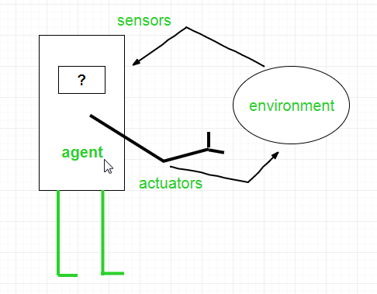
What is AGENT ?
An AI system is composed of an agent and its environment. The agents act in their environment. The environment may contain other agents. An agent is anything that can be viewed as
Perceiving its environment through sensors and
Acting upon that environment through actuators
Note : Every agent can perceive its own actions (but not always the effects)

Slide 4
What is a Agent?
In general, an entity that interacts with its environment to "do the right thing"
Perception through sensors
Actions through effectors or actuators
Intelligent agent-view provides framework to integrate the many subareas of AI.
The right action is the one that will cause the agent to be most successful
An agent is autonomous if its behavior is determined by its own experience (with ability to learn and adapt).

Slide 5
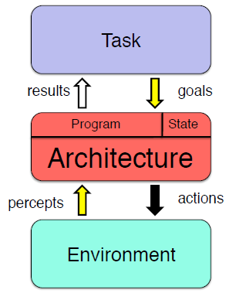
Intelligent Agent

Slide 6
Examples of Agents
Human agent
Eyes, ears, skin, taste buds, etc. For sensors
Hands, fingers, legs, mouth, etc. For actuators
Powered by muscles
Robot
Camera, infrared, bumper, etc. For sensors
Grippers, wheels, lights, speakers, etc. For actuators
Often powered by motors
Software agent
Functions as sensors
Information provided as input to functions in the form of encoded bit strings or symbols
Functions as actuators
Results deliver the output

Slide 7
Agents and Environments
An agent perceives its environment through sensors
The complete set of inputs at a given time is called a percept
The current percept, or a sequence of percepts may influence the actions of an agent.
It can change the environment through actuators
An operation involving an actuator is called an action
Actions can be grouped into action sequences

Slide 8
Agents and Their Actions
A rational agent does “the right thing”
The action that leads to the best outcome under the given circumstances.
An agent function maps percept sequences to actions
Abstract mathematical description.
An agent program is a concrete implementation of the respective function
It runs on a specific agent architecture (“platform”)
Problems:
What is “ the right thing”
How do you measure the “best outcome”

Slide 9
Performance of Agents
Criteria for measuring the outcome and the expenses of the agent.
Often subjective, but should be objective
Task dependent
Time may be important

Slide 10
Performance Evaluation Examples
Vacuum agent
Number of tiles cleaned during a certain period
Based on the agent’s report, or validated by an objective authority
Doesn’t consider expenses of the agent, side effects
Energy, noise, loss of useful objects, damaged furniture, scratched floor
Might lead to unwanted activities
Agent re-cleans clean tiles, covers only part of the room, drops dirt on tiles to have more tiles to clean, etc.

Slide 11
Rational Agent
Selects the action that is expected to maximize its performance
Based on a performance measure
Depends on the percept sequence, background knowledge, and feasible actions

Slide 12
Rational Agent Considerations
Performance measure for the successful completion of a task
Complete perceptual history (percept sequence)
Background knowledge
Especially about the environment
Dimensions, structure, basic “laws”
Task, user, other agents
Feasible actions
Capabilities of the agent

Slide 13
Omniscience
A rational agent is not omniscient
It doesn’t know the actual outcome of its actions.
It may not know certain aspects of its environment.
Rationality takes into account the limitations of the agent
Percept sequence, background knowledge, feasible actions.
It deals with the expected outcome of actions.

Slide 14
Environments
Determine to a large degree the interaction between the “outside world” and the agent
The “outside world” is not necessarily the “real world” as we perceive it.
In many cases, environments are implemented within computers
They may or may not have a close correspondence to the “real world”

Slide 15
Environments – Observable vs Non Observable.
An Observable environment is one in which the agent can obtain complete, accurate, up-to-date information about the environment’s state.
Most moderately complex environments (including, for example, the everyday physical world and the Internet) are Non Observable.
The more Observable an environment is, the simpler it is to build agents to operate in it.

Slide 16
Environments – Deterministic vs. non-Deterministic
A deterministic environment is one in which any action has a single guaranteed effect — there is no uncertainty about the state that will result from performing an action.
The physical world can to all intents and purposes be regarded as non-deterministic.
Non-deterministic environments present greater problems for the agent designer

Slide 17
Environments - Episodic vs. non-Episodic
In an episodic environment, the performance of an agent is dependent on a number of discrete episodes, with no link between the performance of an agent in different scenarios.
Episodic environments are simpler from the agent developer’s perspective because the agent can decide what action to perform based only on the current episode — it need not reason about the interactions between this and future episodes

Slide 18
Environments - Static vs. Dynamic
A static environment is one that can be assumed to remain unchanged except by the performance of actions by the agent.
A dynamic environment is one that has other processes operating on it, and which hence changes in ways beyond the agent’s control.
Other processes can interfere with the agent’s actions (as in concurrent systems theory).
The physical world is a highly dynamic environment.

Slide 19
Environments – Discrete vs. continuous
An environment is discrete if there are a fixed, finite number of actions and percepts in it.
Russell and Norvig give a chess game as an example of a discrete environment, and taxi driving as an example of a continuous one.
Continuous environments have a certain level of mismatch with computer systems.
Discrete environments could in principle be handled by a kind of “lookup table”

Slide 20
Environment Examples
Fully observable vs. Partially observable
Sensors capture all relevant information from the environment
Deterministic vs. Stochastic (non-deterministic)
Changes in the environment are predictable
Episodic vs. Sequential (non-episodic)
Independent perceiving-acting episodes
Static vs. Dynamic
No changes while the agent is “thinking”
Discrete vs. Continuous
Limited number of distinct percepts/actions
Single vs. Multiple agents
Interaction and collaboration among agents
Competitive, cooperative

Slide 21
Examples of different environments
Observable
Deterministic
Episodic
Static
Discrete
Single agent
Word jumble solver
Chess with a clock
Scrabble
Taxi driving
Fully
Fully
Partially
Partially
Deterministic
Strategic
Stochastic
Stochastic
Episodic
Sequential
Sequential
Sequential
Static
Semi_dynamic
Static
Dynamic
Discrete
Discrete
Discrete
Continuous
Single
Multi
Multi
Multi

Slide 22
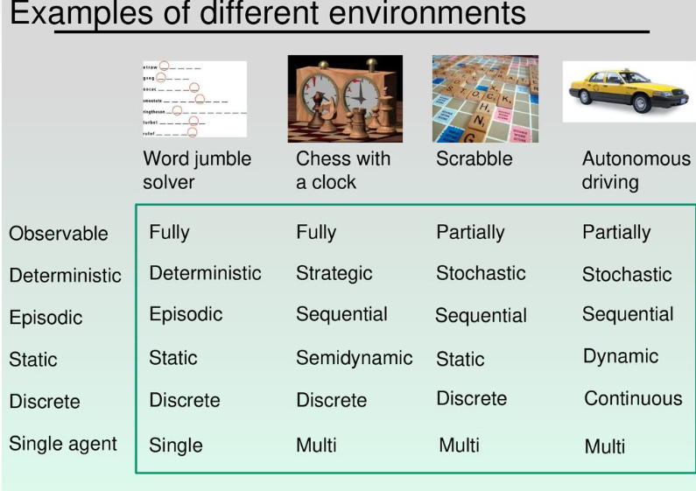
Examples of different environments

Slide 23
Environment Programs
Environment simulators for experiments with agents
Gives a percept to an agent
Receives an action
Updates the environment
Often divided into environment classes for related tasks or types of agents.
Frequently provides mechanisms for measuring the performance of agents.

Slide 24
From Percepts to Actions
If an agent only reacts to its percepts, a table can describe the mapping from percept sequences to actions.
Instead of a table, a simple function may also be used.
Can be conveniently used to describe simple agents that solve well-defined problems in a well-defined environment.
E.G. Calculation of mathematical functions

Slide 25
Agent or Program
Our criteria so far seem to apply equally well to software agents and to regular programs
Autonomy
Agents solve tasks largely independently
Programs depend on users or other programs for “guidance”
Autonomous systems base their actions on their own experience and knowledge
Requires initial knowledge together with the ability to learn
Provides flexibility for more complex tasks

Slide 26
Structure of Intelligent Agents
Agent = Architecture + Program
architecture
operating platform of the agent
computer system, specific hardware, possibly OS functions
program
function that implements the mapping from percepts to actions
emphasis in this course is on the program aspect, not on the architecture

Slide 27
Software Agents
Also referred to as “softbots”
Live in artificial environments where computers and networks provide the infrastructure
May be very complex with strong requirements on the agent
World wide web, real-time constraints,
Natural and artificial environments may be merged
User interaction
Sensors and actuators in the real world
Camera, temperature, arms, wheels, etc.

Slide 28
PEAS description of task environments
Performance measures
Environment
Actuators
Sensors
Used for high-level characterization of agents
Used to evaluate how well an agent solves the task at hand
Surroundings beyond the control of the agent
Determine the actions the agent can perform
Provide information about the current state of the environment

Slide 29
Exercise: VacBot Peas Description
use the PEAS template to determine important aspects for a VacBot agent
vacbot

Slide 30
PEAS description template
Used for high-level characterization of agents
Performance measures
Environment
Actuators
Sensors
How well does the agent solve the task at hand? How is this measured?
Important aspects of the surroundings
Beyond the control of the agent:
Determine the actions the agent can perform.
Provide information about the current state of the environment.

Slide 31
PAGE Description
used for high-level characterization of agents
Percepts
Actions
Goals
Environment
Information acquired through the agent’s
Sensory system
Operations performed by the agent
On the environment through its actuators
Desired outcome of the task with a
Measurable performance
Surroundings beyond the control of the agent

Slide 32
VacBot PEAS Description
Cleanliness of the floor
Time needed
Energy consumed
Performance Measures
Environment
Actuators
Sensors
Grid of tiles
Dirt on tiles
Possibly obstacles, varying amounts of dirt
Movement (wheels, tracks, legs, ...)
Dirt removal (nozzle, gripper, ...)
Position (tile ID reader, camera, GPS, ...)
Dirtiness (camera, sniffer, touch, ...)
Possibly movement (camera, wheel movement)

Slide 33
VacBot PAGE Description
Percepts
Actions
Goals
Environment
Tile properties like clean/dirty, empty/occupied
Movement and orientation
Pick Up Dirt, Move
Desired outcome of the task with a
Measurable performance
Surroundings beyond the control of the agent

Slide 34
SearchBot PEAS Description
Number of “hits” (relevant retrieved items) recall (hits / all relevant items)
Precision (relevant items/retrieved items) quality of hits
Performance Measures
Environment
Actuators
Sensors
Document repository (data base, files, WWW, ...) computer system (hardware, OS, software, ...) network (protocol, interconnection, ...)
Query functions
Retrieval functions
Display functions
Input parameters

Slide 35
StudentBot PEAS Description
Grade
Time Spent Studying
Career Success
Performance Measures
Environment
Actuators
Sensors
Classroom, University, Universe
Human actuators
Human sensors

Slide 36
StudentBot PAGE Description
Percepts
Actions
Goals
Environment
Images (Text, Pictures, Instructor, Classmates)
Sound (Language)
Comments, Questions, Gestures
Note-taking (?)
Mastery of the material
Performance measure: grade
Classroom

Slide 37
Agent: Part-sorting robot
Performance measure
Percentage of parts in correct bins
Environment
Conveyor belt with parts, bins
Actuators
Robotic arm
Sensors
Camera, joint angle sensors

Slide 38
Agent: Spam filter
Performance measure
Minimizing false positives, false negatives
Environment
A user’s email account
Actuators
Mark as spam, delete, etc.
Sensors
Incoming messages, other information about user’s account

Slide 39
Agent Programs
The emphasis in this course is on programs that specify the agent’s behavior through mappings from percepts to actions
Less on environment and goals
Agents receive one percept at a time
They may or may not keep track of the percept sequence
Performance evaluation is often done by an outside authority, not the agent
More objective, less complicated
Can be integrated with the environment program

Slide 40
Skeleton Agent Program
Basic framework for an agent program
Function skeleton-agent(percept) returns action
Static: memory
Memory := update-memory(memory, percept)
Action := choose-best-action(memory)
Memory := update-memory(memory, action)
Return action

Slide 41
Agent Program Types
Different ways of achieving the mapping from percepts to actions
Different levels of complexity
Simple reflex agents
Agents that keep track of the world
Goal-based agents
Utility-based agents
Learning agents

Slide 42
Simple Reflex Agent
Instead Of Specifying Individual Mappings In An Explicit Table, Common Input-Output Associations Are Recorded
Requires Processing Of Percepts To Achieve Some Abstraction
Frequent Method Of Specification Is Through Condition-Action Rules
If Percept Then Action
Similar To Innate Reflexes Or Learned Responses In Humans
Efficient Implementation, But Limited Power
Environment Must Be Fully Observable
Easily Runs Into Infinite Loops

Slide 43
Reflex Agent Diagram
Sensors
What the world is like now
Environment
Condition-action rules
What should I do now
Agent
Actuators

Slide 44
Reflex Agent Program
Application of simple rules to situations
function SIMPLE-REFLEX-AGENT(percept) returns action
static: rules //set of condition-action rules
condition := INTERPRET-INPUT(percept)
rule := RULE-MATCH(condition, rules)
action := RULE-ACTION(rule)
return action

Slide 45
Model-Based Reflex Agent
An internal state maintains important information from previous percepts
Sensors only provide a partial picture of the environment
Helps with some partially observable environments
The internal states reflects the agent’s knowledge about the world
This knowledge is called a model
May contain information about changes in the world
Caused by actions of the action
Independent of the agent’s behavior

Slide 46
Model-Based Reflex Agent Diagram
Sensors
State
What the world is like now
How the world evolves
What my actions do
Condition-action rules
What should I do now
Agent
Actuators
Environment

Slide 47
Model-Based Reflex Agent Program
Application of simple rules to situations
Function reflex-agent-with-state(percept) returns action
Static: rules //set of condition-action rules
State //description of the current world state
Action //most recent action, initially none
State := update-state(state, action, percept)
Rule := rule-match(state, rules)
Action := rule-action[rule]
Return action

Slide 48
Goal-Based Agent
The agent tries to reach a desirable state, the goal
May be provided from the outside (user, designer, environment), or inherent to the agent itself
Results of possible actions are considered with respect to the goal
Easy when the results can be related to the goal after each action
In general, it can be difficult to attribute goal satisfaction results to individual actions
May require consideration of the future
What-if scenarios
Search, reasoning or planning
Very flexible, but not very efficient

Slide 49
Goal-Based Agent Diagram
Sensors
State
What the world is like now
How the world evolves
What happens if I do an action
What my actions do
Goals
What should I do now
Agent
Actuators
Environment

Slide 50
Utility-Based Agent
More sophisticated distinction between different world states
A utility function maps states onto a real number
May be interpreted as “degree of happiness”
Permits rational actions for more complex tasks
Resolution of conflicts between goals (tradeoff)
Multiple goals (likelihood of success, importance)
A utility function is necessary for rational behavior, but sometimes it is not made explicit

Slide 51
Utility-Based Agent Diagram
Sensors
State
What the world is like now
How the world evolves
What happens if I do an action
What my actions do
How happy will I be then
Utility
What should I do now
Agent
Actuators
Environment

Slide 52
Learning Agent
Performance element
Selects actions based on percepts, internal state, background knowledge
Can be one of the previously described agents
Learning element
Identifies improvements
Critic
Provides feedback about the performance of the agent
Can be external; sometimes part of the environment
Problem generator
Suggests actions
Required for novel solutions (creativity)

Slide 53
Learning Agent Diagram
Performance
Standard
Sensors
Critic
State
What the world is like now
Learning
Element
How the world evolves
What happens if I do an action
What my actions do
How happy will I be then
Utility
What should I do now
Problem
Generator
Agent
Actuators
Environment

Slide 54
Summary: Simple Reflex agents
Simple Reflex agents: Takes action based on only the current environment situation it maps the current percept into proper action ignoring the history of percepts. The mapping process could be simply a table-based or by any rule based matching algorithm. Example of this class is a robotic vacuum cleaner that deliberate in an infinite loop, each percept contains a state of a current location [clean] or [dirty] and accordingly it decides whether to [suck] or [continue-moving].

Slide 55
Summary: Model-based Reflex agents
Model-based Reflex agents: Needs memory for storing the percept history, it uses the percept history to help revealing the current unobservable aspects of the environment. example of this IA class is the self-steering mobile vision where it's necessary to check the percept history to fully understand how the world is evolving.

Slide 56
Summary: Goal-based Reflex agents
Goal-based Reflex agents: This kind of IA has a goal and has a strategy to reach that goal, All actions are based on its goal and from a set of possible actions it selects the one that improves the progress towards goal (not necessarily the best one). Example of this IA class is any searching robots that has initial location and want to reach a destination.

Slide 57
Summary: Utility-based Reflex agents
Utility-based Reflex agents: Like the Goal-based agent but with a measure of "how much happy" an action would make me rather than the goal-based binary feedback ['happy', 'unhappy'], this kind of agents provide the best solution, an example is the route recommendation system which solves for the 'best' route to reach a destination.

Slide 58
Summary: Learning agents
Learning agents: The essential component of autonomy, this agent is capable of learning from experience, it has the capability of automatic information acquisition and integration into the system, any agent designed and expected to be successful in an uncertain environment is considered to be learning agent.

Slide 59
Summary
Agents perceive and act in an environment
Ideal agents maximize their performance measure
Autonomous agents act independently
Basic agent types
Simple reflex
Reflex with state
Goal-based
Utility-based
Learning
Some environments may make life harder for agents
Inaccessible, non-deterministic, non-episodic, dynamic, continuous

Slide 60


